Slide 1

Social Media Audit
James Milligan

Slide 2
Social Media Analysis:
Facebook SWAT
Strength: Engaged Up to date What liberal supporters want to hear Emphasises James’ views/personality Relevant to community issues and campaign | Weakness: Comes across very ‘planned’. Impersonal Smaller target audience - how far is his reach? Closed group engagement
Opportunities: Engagement of larger audience; trying to communicate with different demographics Emphasis James as a member of the community and parliament: community interest being heard Advertising tool for James | Threats: Advertising/ marketing tool for James - can be taken the wrong way Other MLAs posting similar content
Facebook is a more ‘formal’ platform, where it is easier to communicate with the current target audience. Facebook allows for longer posts which community members are more likely to engage with. Enhancing his public image in Facebook will allow the broader audience to associate him more with the Liberal Party and James’ individual campaigns.

Slide 3
Instagram: SWAT
Strength: Shows more BTS of James and his campaign Pictures highlight the public interests Pictures highlight James with members of the community | Weakness: Small follower base lower community engagement/interaction through followers Less personal Aesthetic of the page - Instagram is all about the look
Opportunities: Room for better community engagement Target the younger voters Increase James’ personality - make it less political and showcase his ‘normal side’ | Threats: Smaller community engagement Seems very ‘commercial’ - almost forced
Instagram is a more informal platform where aesthetics count for the most part. Instagram can be used to engage with the younger generations, so taking advantage so James’ humour might be a good way to push through more content through the BTS and more community engagement within the Yerrabi area

Slide 4
Twitter: SWAT
Strength: Good stakeholder engagement - reposting of Canberran affairs Higher following - more reach | Weakness: Some long tweets - twitter is supposed to be short and sharp.
Opportunities: Can be used to highlight a more Whitty, humours side of James Allowed less serious | Threats: Other MLAs posting similar content same content posted as other platforms
On the rise in Australia Twitter is a good way to engage with journalists and highlight James as more of an individual rather than a member of the Liberal party. Maybe begin to use to highlight opposition wrongdoing / what James can and will do better, with a humours twist.

Slide 5
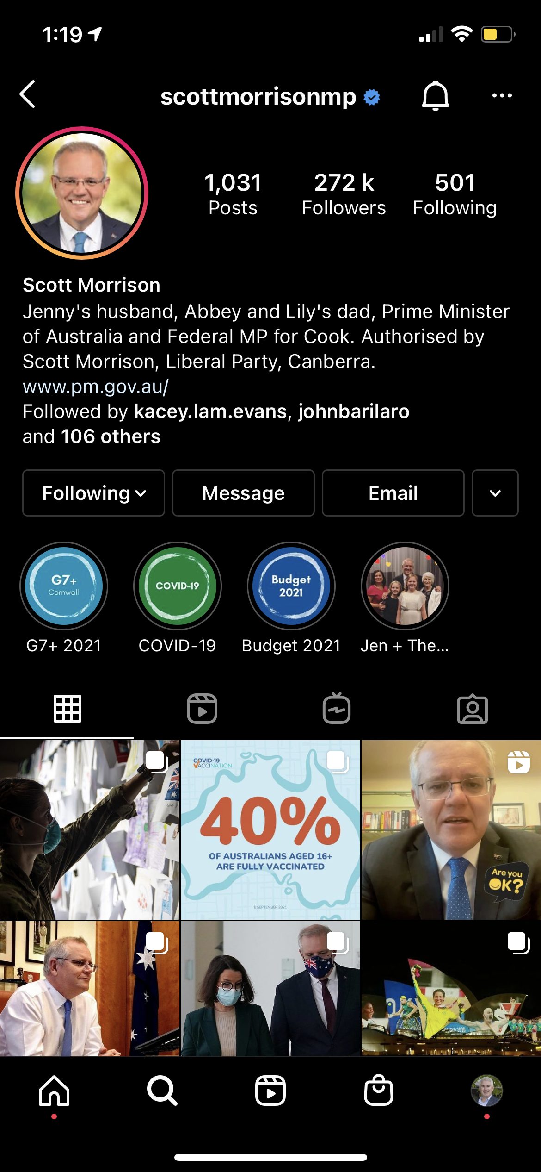
Scott Morrison – Federal
Comparative Account Analysis:
272K followers
‘Jenny’s Husband, Abbey and Lily’s dad’
  Highlights his priorities as a family man
Highlighted stories of past campaigns
  Allows viewers easy access to content
Posted content isn’t just politics, family photos and tributes as well: R U OK day
Regular story updates
No anti-Labor posts

Slide 6
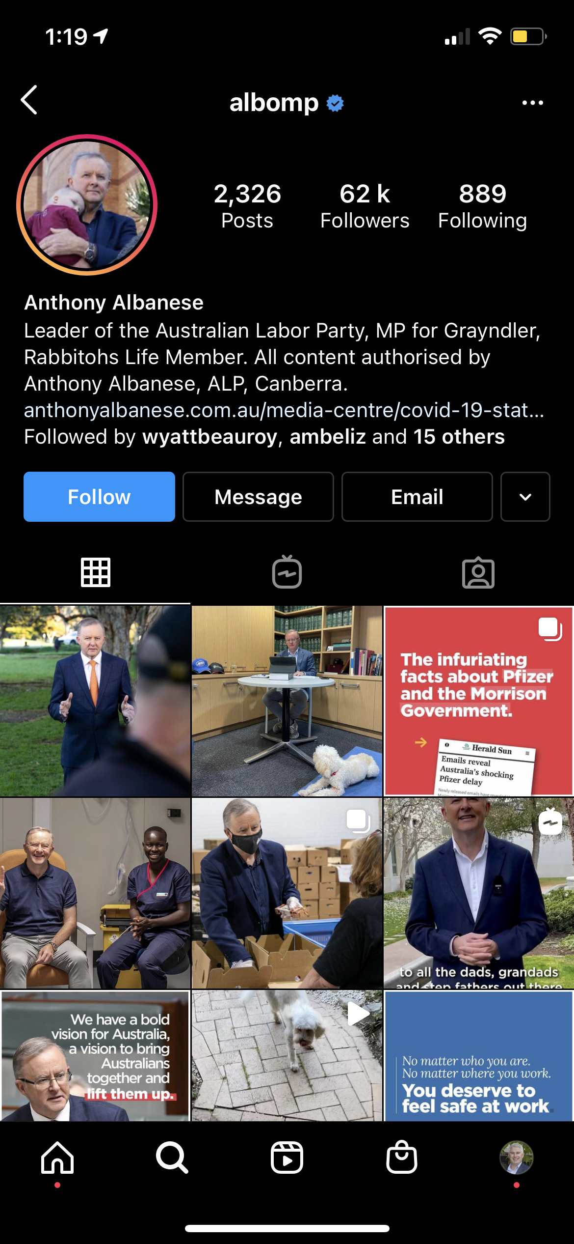
Anthony Albanese – Federal
62k Followers
Highlighted stories from past campaigns
  Allows viewers easy access to content
More of a political theme throughout page, posts also used to antagonise Liberals
  Doesn’t allow viewers to see an alternative side to his personality
Highlights more of his political agenda – rather than being approachable

Slide 7
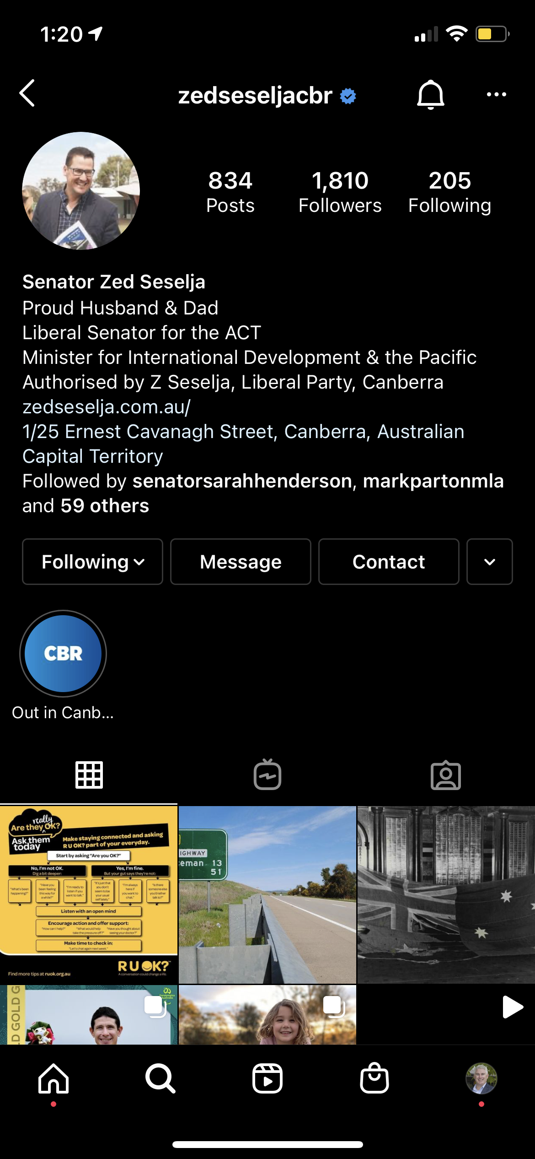
Zed Seselja – Liberal State Senator
1,810 followers
Bio highlights his family priorities before politics
Before campaign time, feed was equal with family oriented / everyday life and politics
Low engagement through likes and comments
Limited highlighted stories
Linked Website and Office location – easy communication for public interest

Slide 8
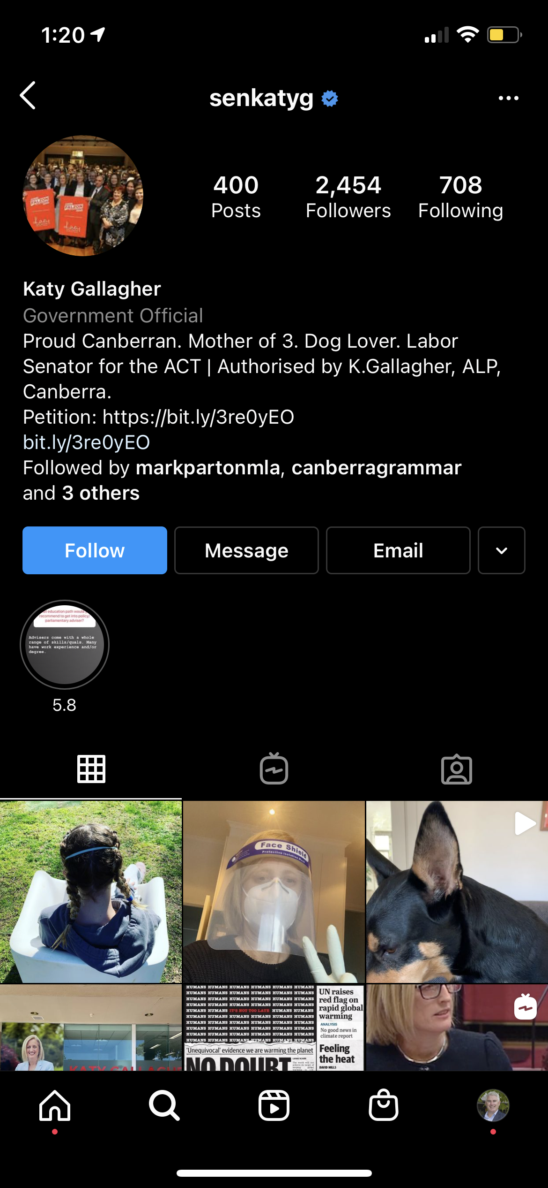
Katy Gallagher – Labor State Senator
2, 454 followers
Bio highlights where she is from and what she is proud of
Politically themed throughout feed
Anti-Liberal posts
Minimal community engagement through likes and comments
Generic looking political Instagram page

Slide 9
Public trust of Politicians
Within the first month of using Twitter, politicians were able to raise between 1% and 3% of what they would have raised in a two-year traditional campaign.
Declining media trust is related not only to the disruptive changes in the media but also to the general decline of trust in institutions.
Voters deem politicians as more honest in social media and opinion pieces, compared to talk shows and news interviews.
Young people typically found politicians to be more dishonest in mainstream media compared to social media.
Voters tend to evaluate populist politicians as more authentic than traditional politicians.
The legitimacy of the media is contested from various perspectives and by various political actors

Slide 10
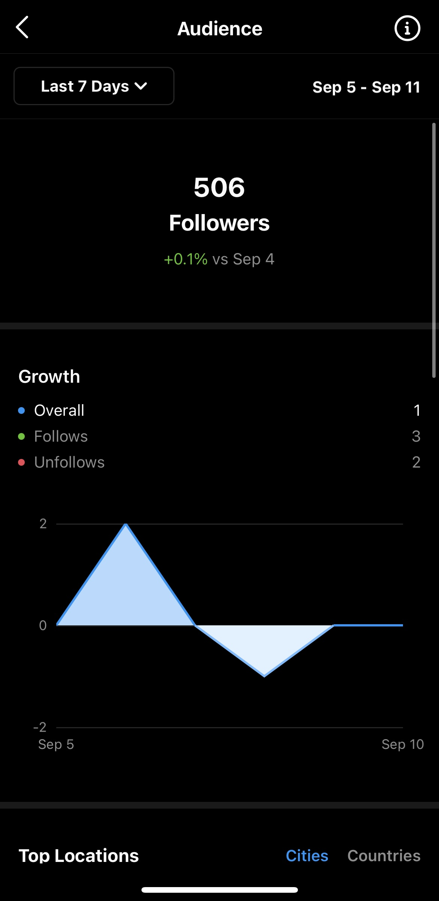
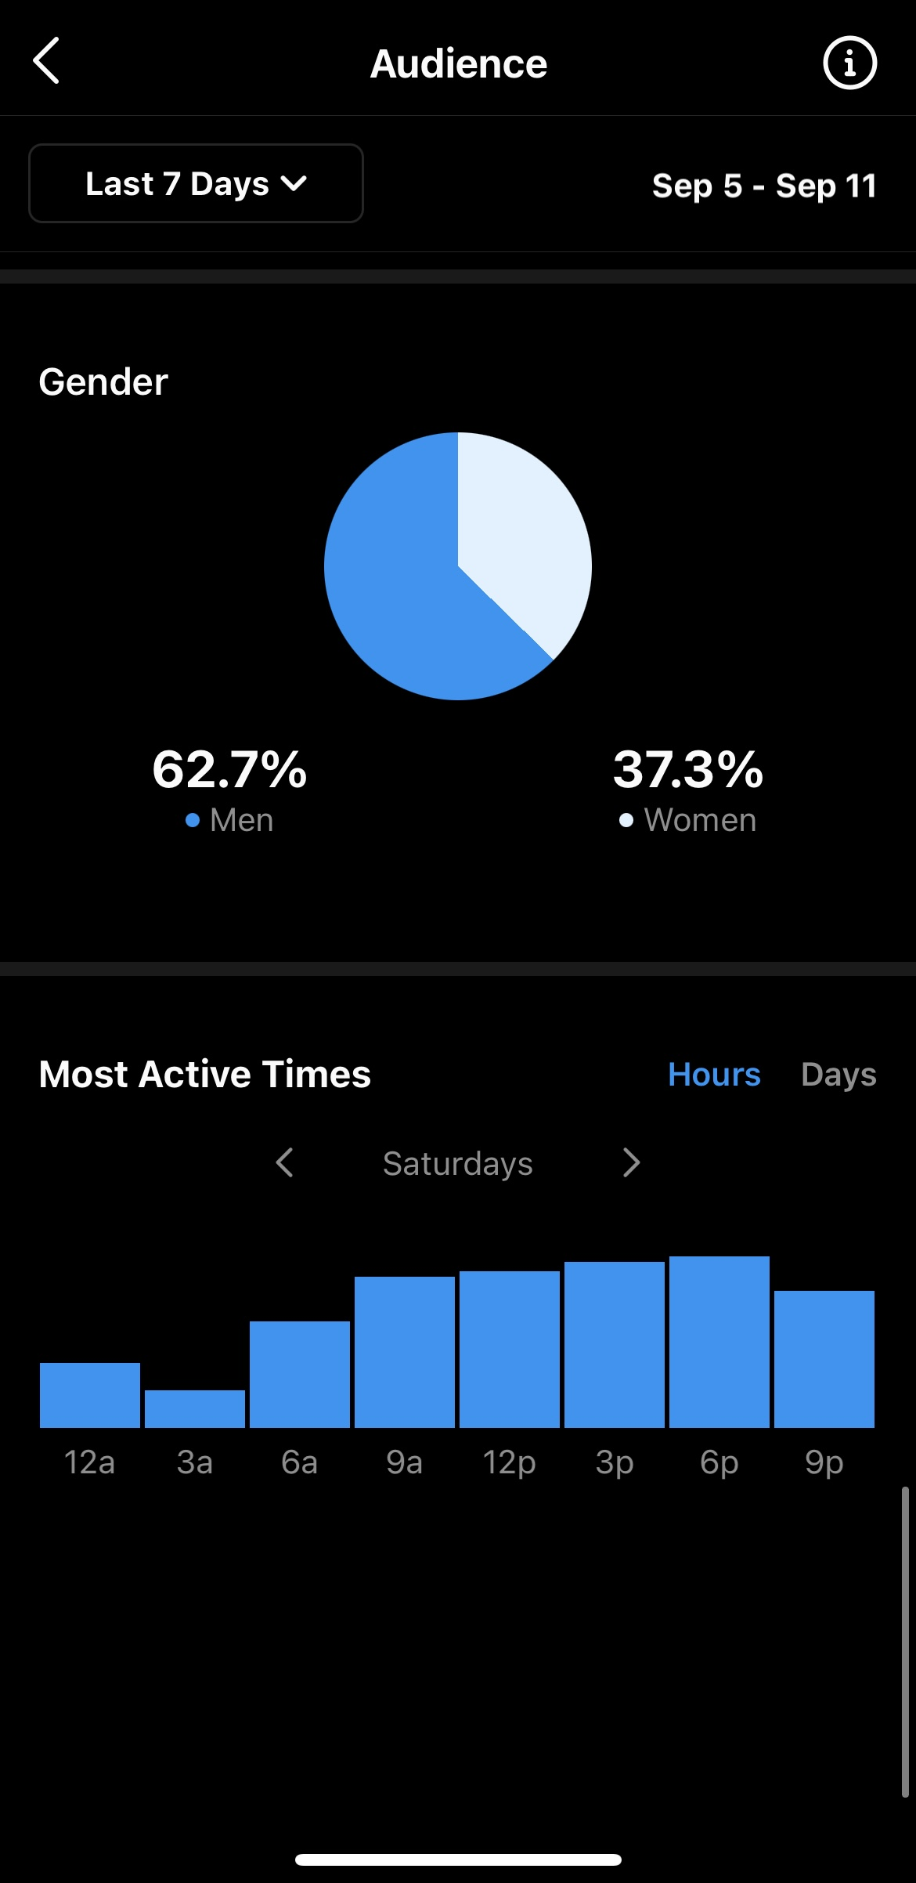
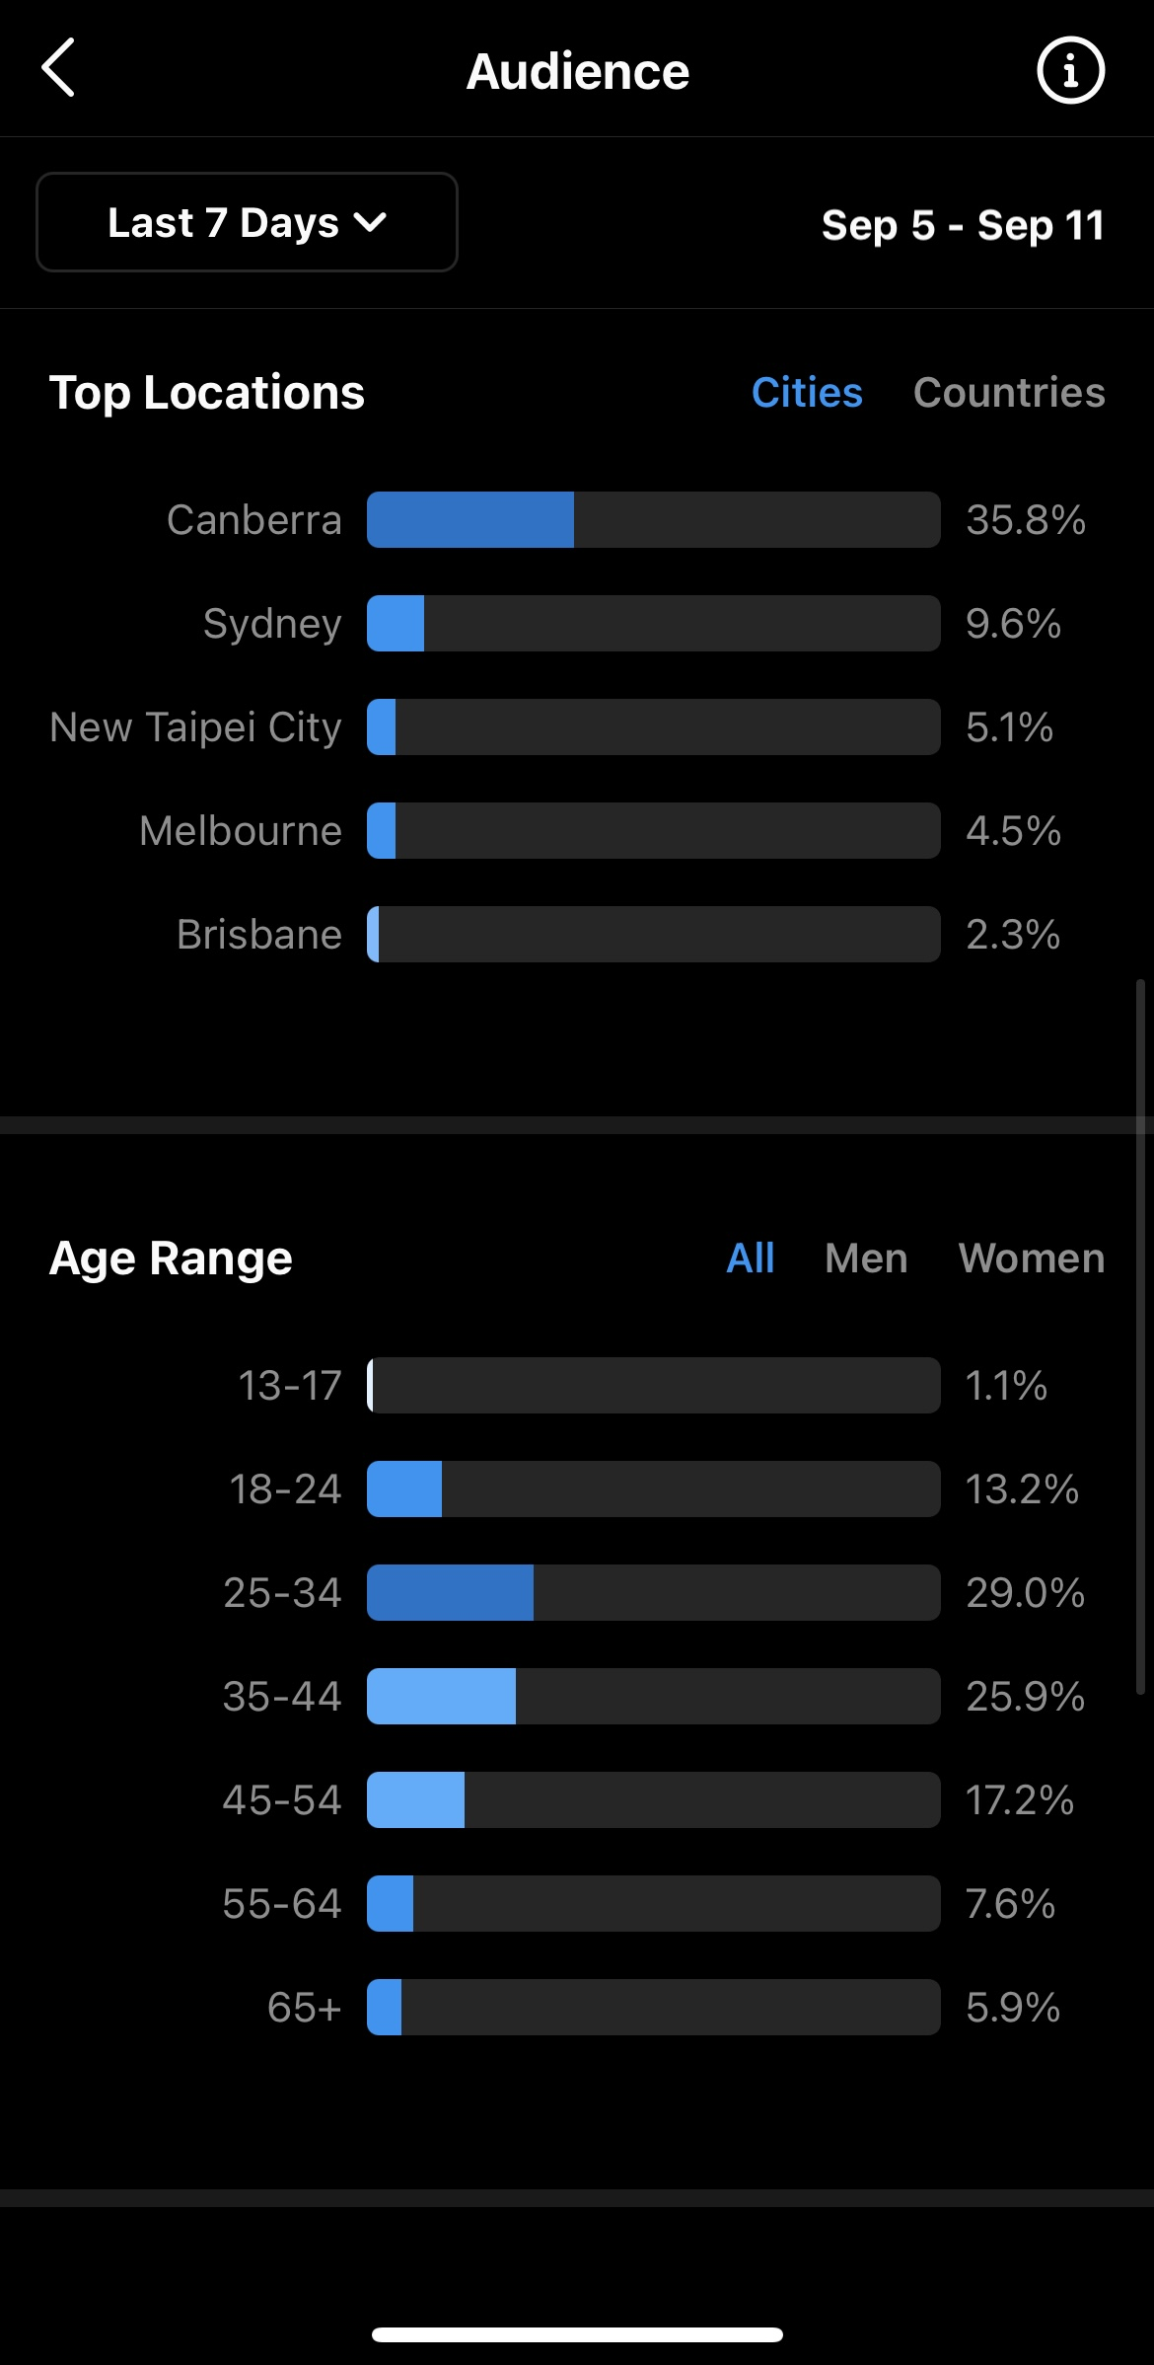
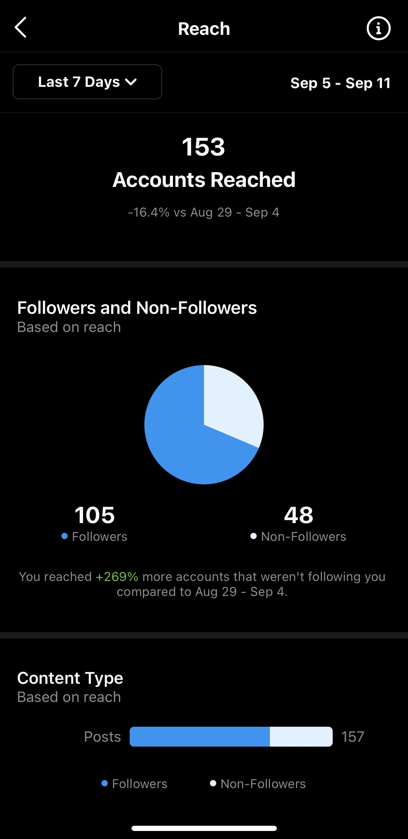
Analytics: Instagram
Notes:
Reach is the total number of people who see your content. Impressions are the number of times your content is displayed, no matter if it was clicked or not. Think of reach as the number of unique people who see your content.. However, an impression means that content was delivered to someone's feed.

Slide 11
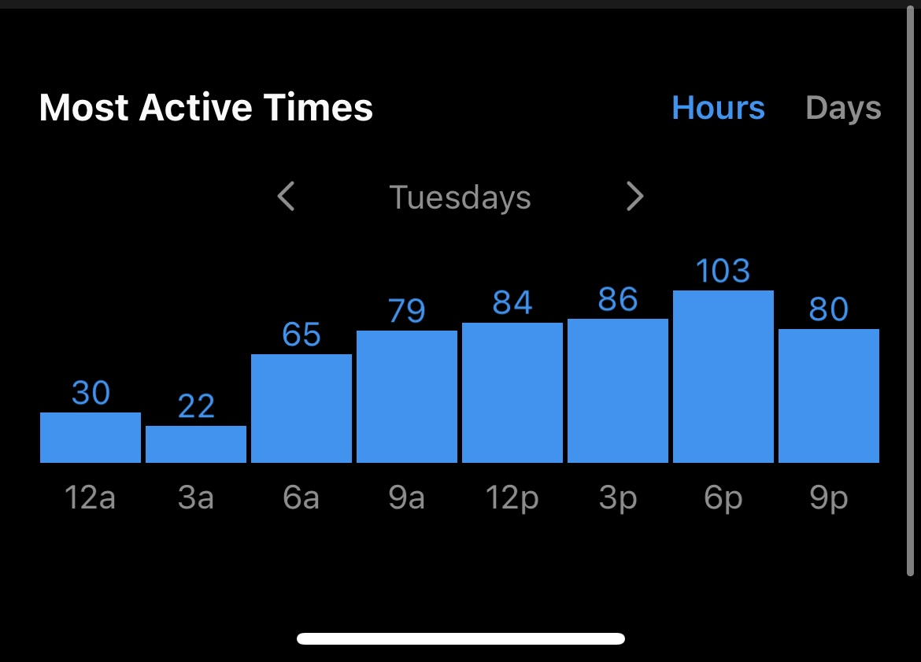
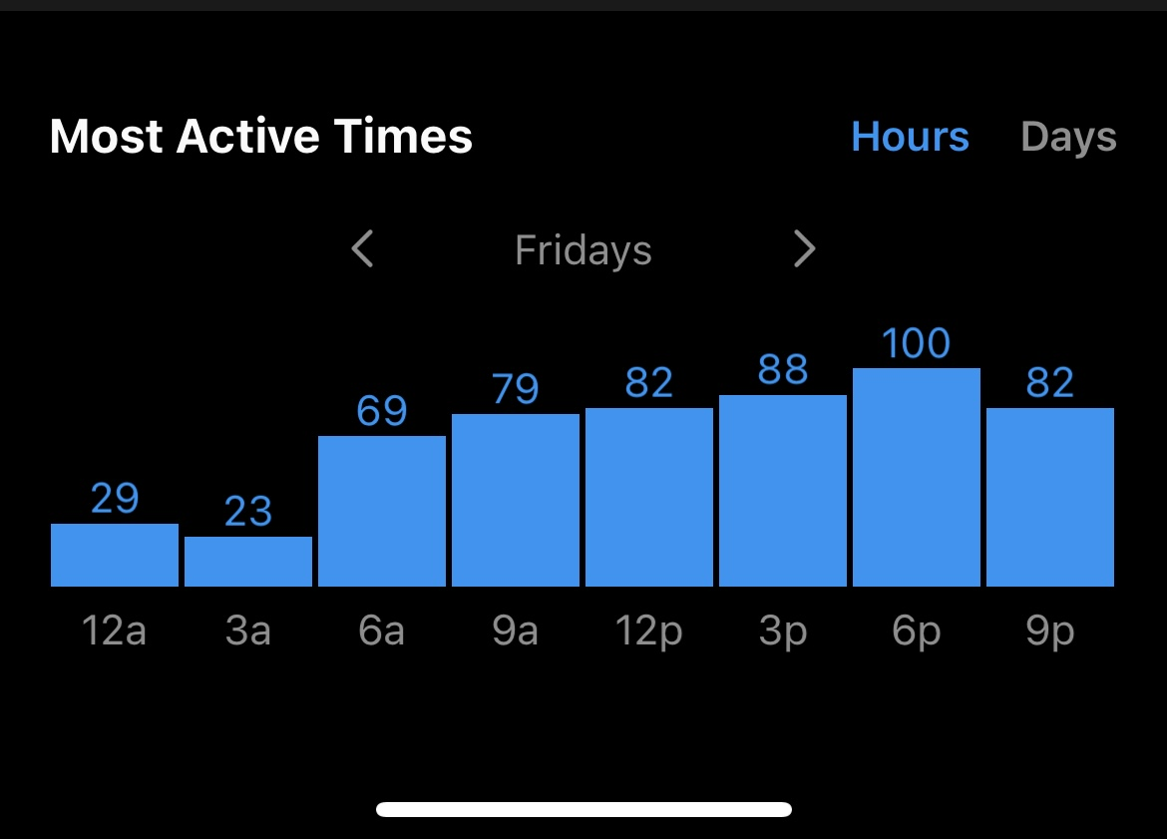
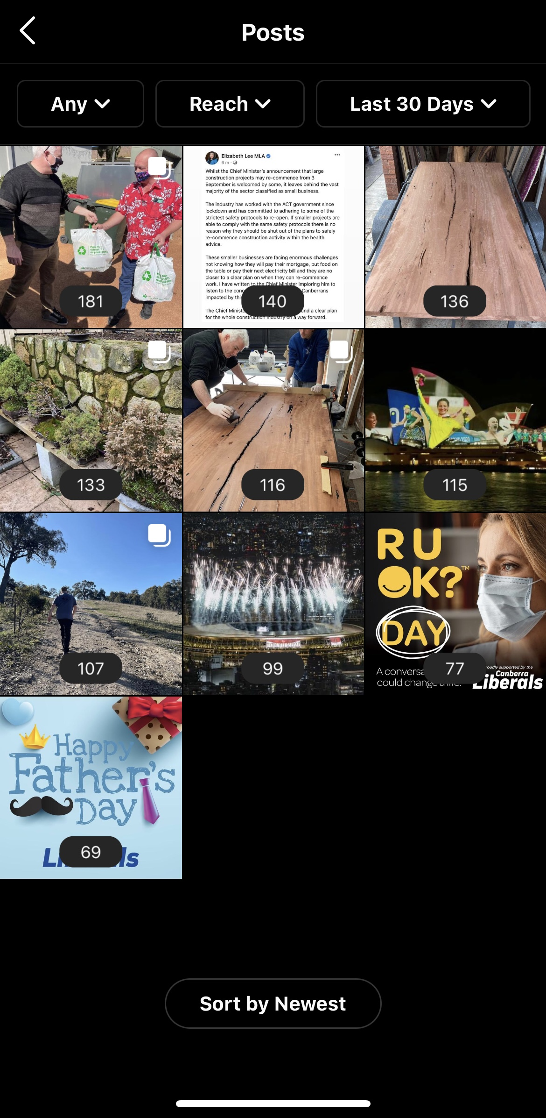
Analytics: Instagram
Notes:
Most common interactive time is around 6pm on weekdays and afternoons on the weekends (12-6pm)

Slide 12
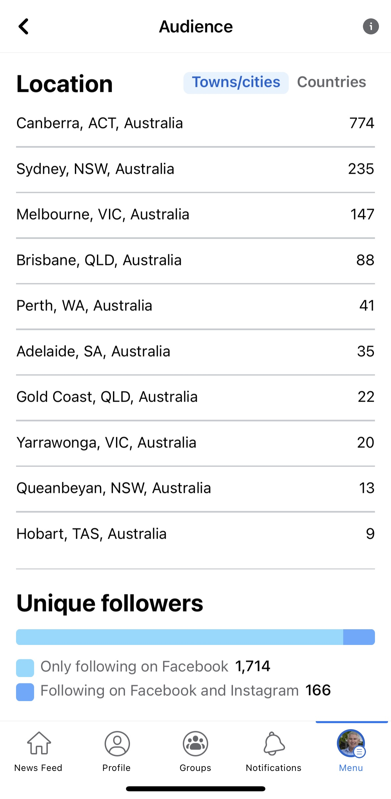
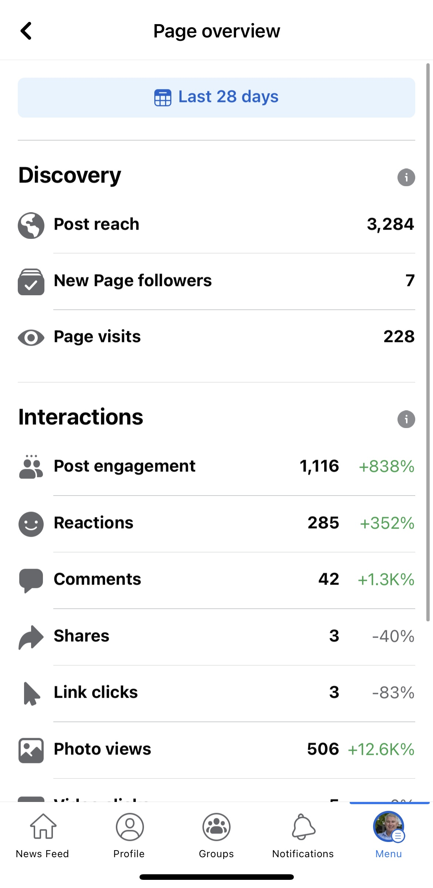
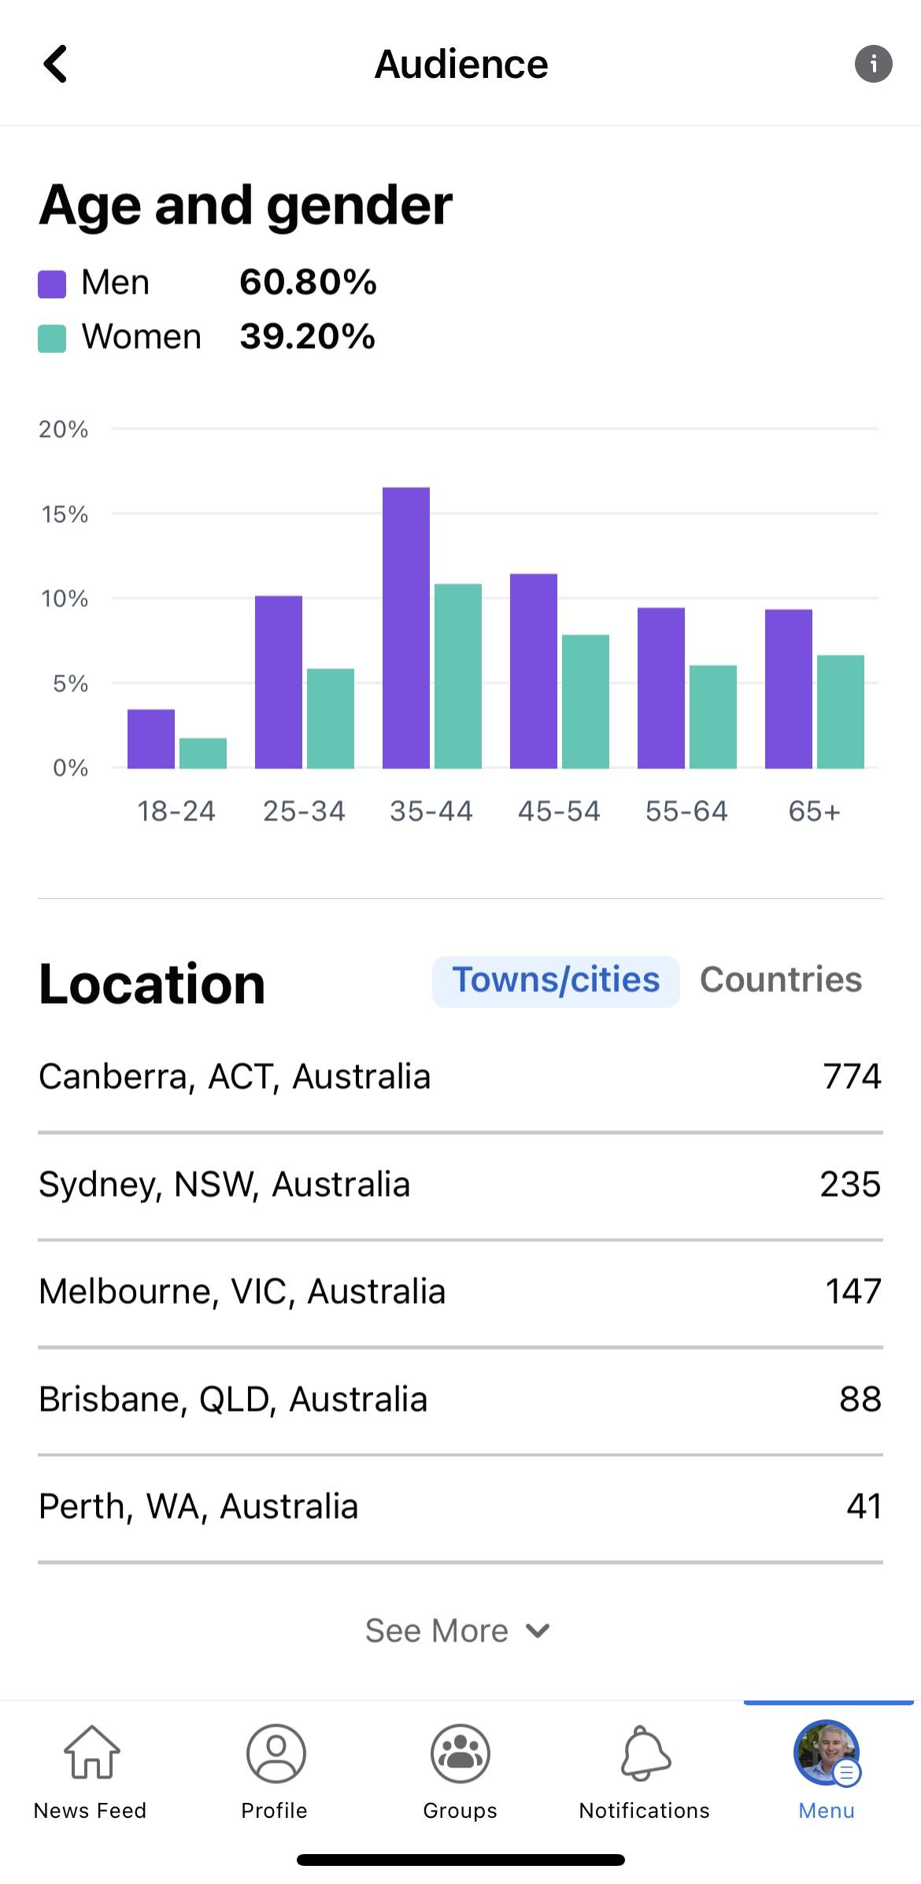
Analytics: Facebook
Notes:
Note Unique followers: How do we get the followers from Facebook over to Instagram?

Slide 13
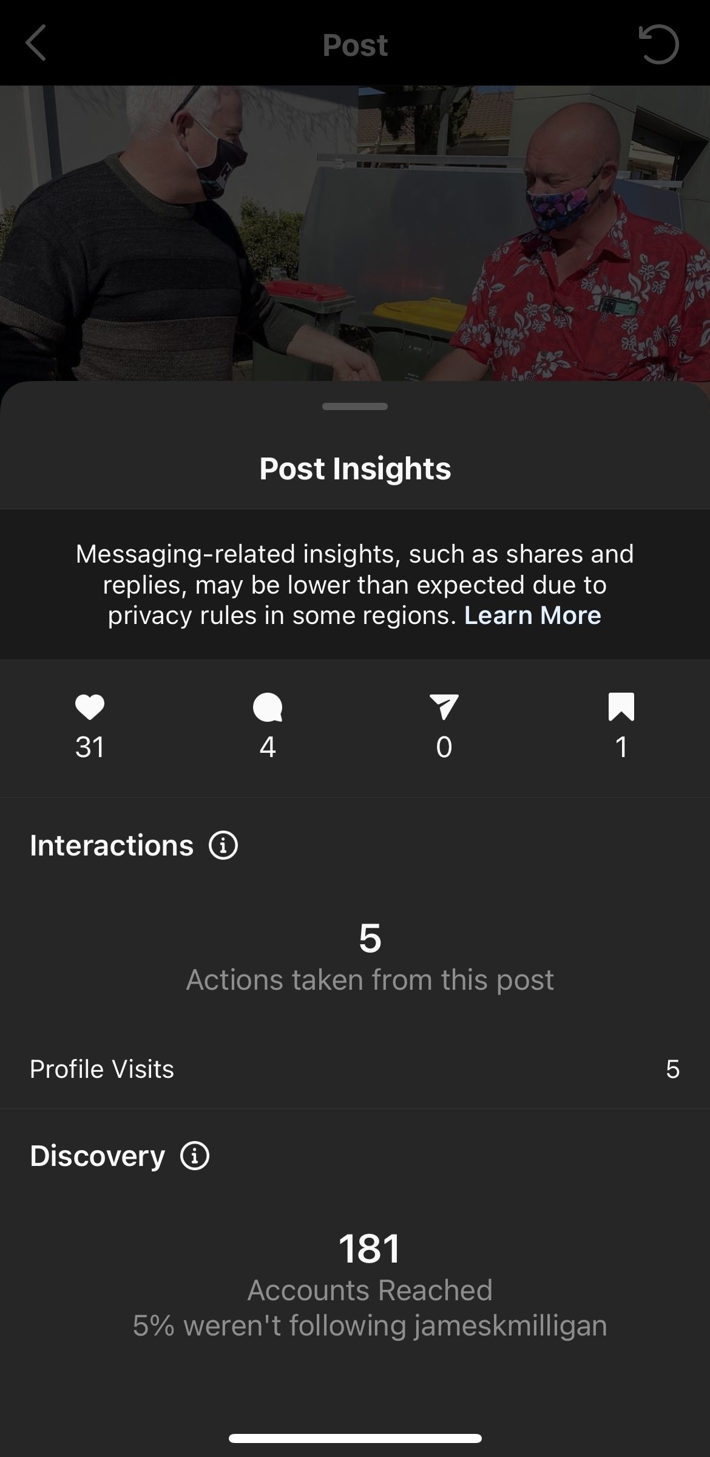
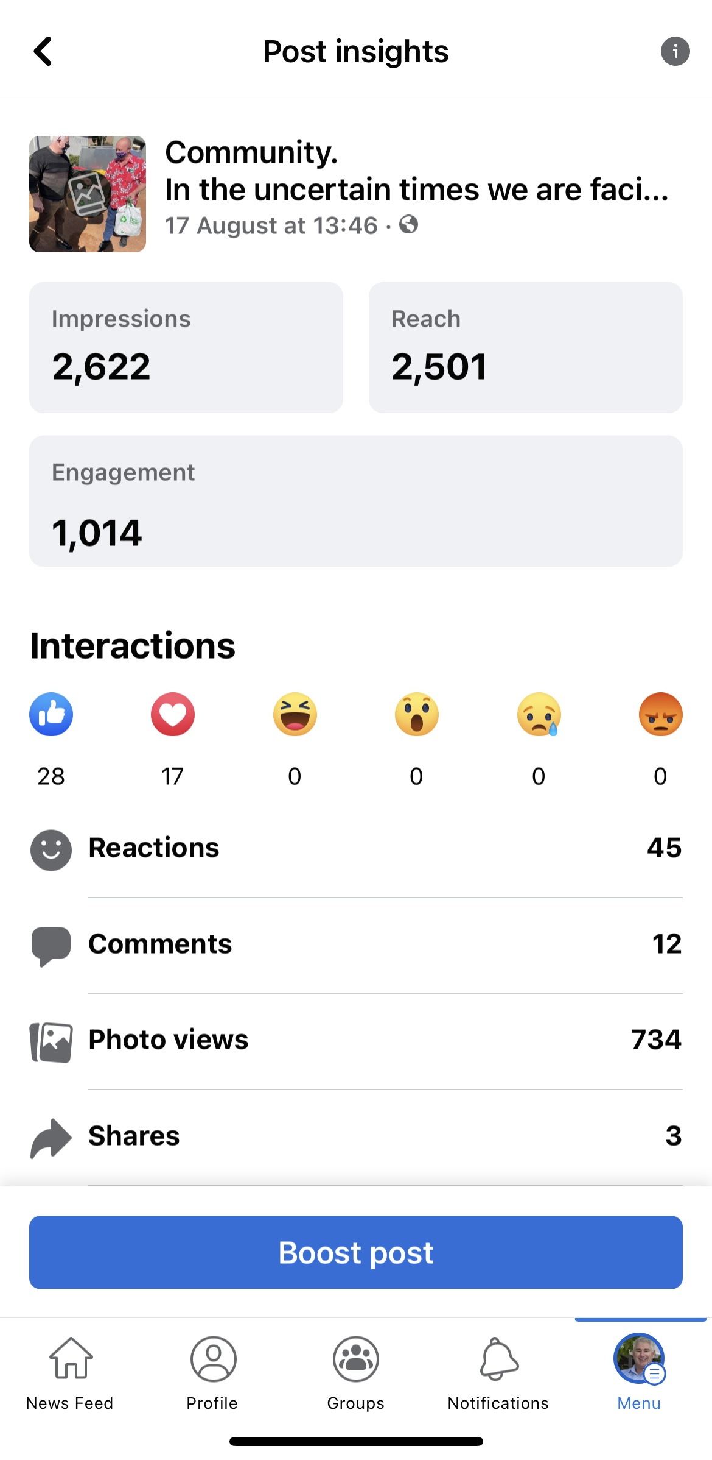
Comparison
Notes:
Significantly the post with the most interactions on both platforms - Facebook gained more reaction and reach though,

Slide 14
Media Studies
Research on trust can broadly be divided into three main realms:
Media trust, the degree to which audiences trust or distrusts the media, particularly in the debate about fake news.
Impact on political trust, the degree to which exposure to various media contents increases or decreases trust in politics and government.
Performed politics, the degree to which politicians come across as authentic and trustworthy in the context of their media performances.

Slide 15
Where to go now?
It is said that exposure to online news is positively associated with higher political trust.
In order to grow James’ social media presence, it would be beneficial to highlight more of his personal, family man side rather than a political agenda.
Of course, there will be aspects which highlight a political agenda, but it needs to be executed in a way which can be interpreted by the general public and grown by local news.

Slide 16
Implementation
Re-posting of local / Political News stories
  Gungahlin Regional News: James does not have to be exclusively apart of, just relevant to the region
Call - to- actions of followers enhance engagement
  ‘Where is your favorite place in Gungahlin?’
  ‘Where will James see you today?’
  ‘pop down and have a chat!’
Posting of more Op-Ed pieces James has written
  Allows audiences to level with James’ opinion as well as his political opinion
Use of more tailored and specific hashtags
  Hashtags are used to reach a broader audience, by being consistent with hashtags an audience can affiliate that tag, with your brand
  E.g. Yerrabi, Gungahlin, JamesMilliganMLA, Liberal

Slide 17
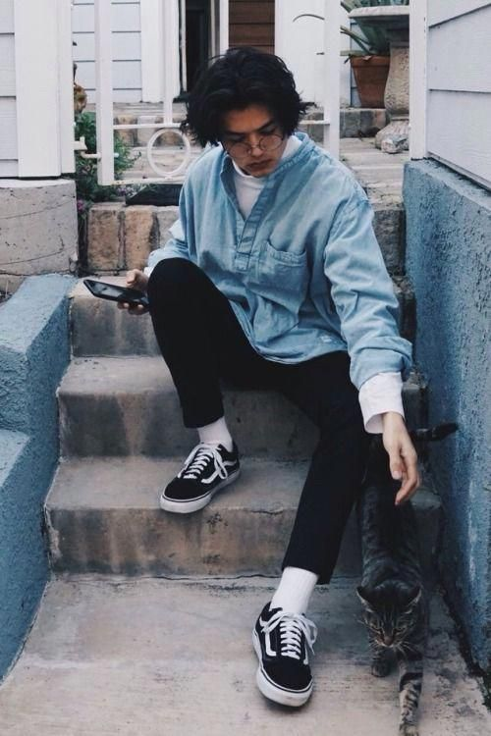
Persona’s – Jackson
Background:
19 yrs, New Voter
Swinger Family
Lives in Canberra, ACT
Full-time CIT student, studying Art
lives at home with family
enjoys supporting small, local businesses: Cafes and art hotspots
Goals / Influences:
influenced by famous artists: Picasso, Matisse and Van Gogh
Aims to run his own graphic design studio
Finances:
Works part-time at a local artsy cafe to support study
Excess money for used fun
Day In the Life:
Early mornings and late nights - runs off caffeine
Goes to work 4-5 days a week
In between working hours, Jack fits in his CIT. Sets aside time to do classwork
Skateboards or uses public transport to get around
always in a rush
Balances his social life on top of work and study
Recreational activities:
find him at the skate park or getting a tattoo
Enjoys finding other forms of art expression
Scouring the national galleries for new pieces put on display

Slide 18
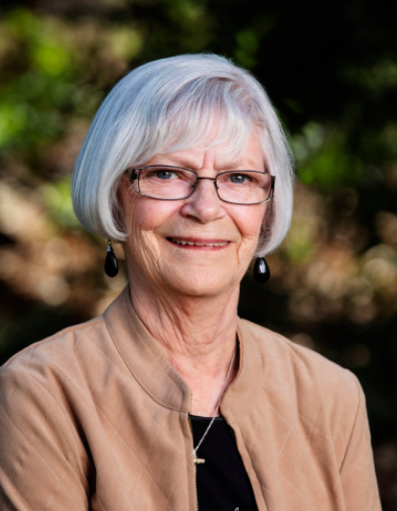
Persona – Barbra
Background:
62, Married
Lives in Canberra, ACT
Retired
Lifetime liberal voter
Wants to see change in the ACT
Finances:
Paid off the house
Lives off pension and saved money over her lifetime
Goals / influences:
Aims to enjoy her retirement through time spent with her family traveling Australia
Influenced by her grandkids to slow down and enjoy life
Day in the life:
First one up and the first one to bed
Enjoys a morning coffee at a local cafe where she reads the paper
Walks a different route every day to stay active
Drives/walks where she needs to go
Recreational activities:
Enjoys spending the weekends with her grandkids, taking them to immersive spots in Canberra

Slide 19
Voice and Tone
A strong brand voice and tone will enable a social media account to succeed.
To achieve this we need to:
Plan an outline of our goals and objectives;
Determine the theme of our account; and
Be consistent
We also need to choose our tone of voice to connect well with our target audience and establish our aesthetic. There are four main dimensions of tone of voice.
Humour;
Formality;
Respectfulness; and
Enthusiasm
The use of enthusiasm and respect will make sure we are reaching our target audience effectively.
Persona 1 - Jackson:
One of Jackson’s aims is to own his own Graphic design studio. If our posts are enthusiastic, Jackson may be more exposed to how our campaign initiatives will help him achieve his long-term goals
If we write in an enthusiastic way, this will show Jackson that we have his interests at heart
Persona 2 - Barbara:
Barbara enjoys spending weekends with her grandkids. Our page will need to be respectful in terms of what we post and highlight how our core values are family orientated.

Slide 20
Dealing with Audience Engagement
Responding to the audience:
Replying to comments, maintaining account tone and voice.
Answering queries within comments in a timely manner.
2-way communication:
Two-way communication will be achieved through ongoing audience interactions, including asking questions and replying to comments. There will be a focus on asking followers what type of content they would like to see. This way, the accounts can move away from the one-way communication model by allowing followers to have a say about the type of content being posted. The aim is to avoid ‘talking at’ followers, but rather including them in conversations.

Slide 21
Content Calendar
A content calendar is developed for an institution to remain consistent with their social media content
Content calendars allow for a consistent theme and enforce strategy throughout platforms
While this is new for our office, and the introduction of posting on more platforms this content calendar will be quite simple and follow a rotating theme.

Slide 22
Monday | Tuesday | Wednesday | Thursday | Friday | Saturday | Sunday
Start of the week post News article ‘Fun’ Monday call to action | Portfolio Post What are we working on in the space of _ | Electorate post What is going on in the electorate? What are we working on |  | Portfolio post Electorate post | Weekend events (if any)
Each Post should:
Rotating weekly theme; each week focusing on one particular portfiolo with electorate mixed it
Have some form of call to action for the audience to engage with: Poll, Questions ect.
Follow the JM 2.0 Brand through tone and voice
Each post should have a purpose – No fluff posts
Always thinking about who we want to target? Is the relative to the ‘Jackson’ Persona OR the ‘Barbra’ Persona.
  How do we effectively target both?

Slide 23
Bibliography
Enli, G. Rosenberg, L., (2018). Trust in the Age of Social Media: Populist Politicians seen more Authentic
Wharton. U., (2020). How Social Media Is Shaping Political Campaigns, https://knowledge.wharton.upenn.edu/article/how-social-media-is-shaping-political-campaigns/
McCready, R. (2018, July 23). 4 Simple Ways to Develop a Strong Brand Voice on Instagram. Iconosquare Blog. https://blog.iconosquare.com/develop-brand-voice-on-instagram/
Morgan, K. (2019, July 17). The Four Dimensions of Tone of Voice. Nielsen Norman Group. https://www.nngroup.com/articles/tone-of-voice-dimensions/

